Slide 1
Introduction to Game AI Workshop
Session 2: Mimicking the Mind
https://github.com/jharger/AIWorkshop

Slide 2

Workshop Plan
Intro & Steering Behaviors
Behavior Trees & Memory
Path Finding
Planning

Slide 3
Agent-based Simulation
Each entity/character/creature is an “agent”
Each agent is independent of all others
Has its own knowledge and memory
Makes its own decisions based entirely on its own info
However, an agent may be given information or orders from other agents

Slide 4
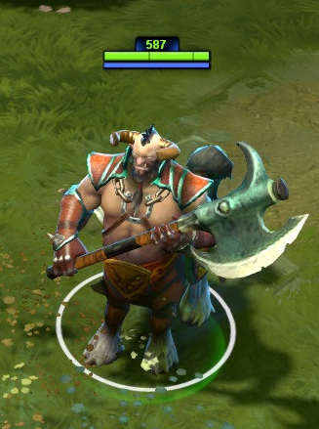
MOBA Character Example
AI Controller
KB/Mouse Controller
Path Finding
Steering Behaviors
Animator
Locomotion
Game Mechanics
(skills, etc)
Modularized our Shared code yaaaay!

Slide 5
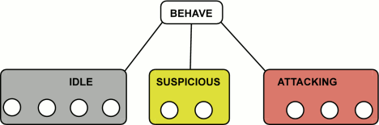
What are Behavior Trees?
First presented at GDC 2005.
They are a visual programming language.
They are similar to finite-state-machines (FSM) but they have a hierarchical, modular design.
Img Source: http://aigamedev.com/open/article/bt-overview/#StatesorBehaviors
Original paper:
http://www.gamasutra.com/view/feature/130663/gdc_2005_proceeding_handling_.php

Slide 6
What are Behavior Trees?
They are executed on a periodic basis (i.e. a tick) at a low rate, such as 10hz.
Each branch of the tree is potentially reusable.
Each node may have an execution state, such as “running”, “completed successfully” or “failed”

Slide 7
Selector
Attack State
Patrol State
Sequence
No enemy near?
Sequence
Enemy Near?
Parallel
Move to Enemy
Fire Weapon
Pick Patrol Point
Move to Patrol Point
Example Behavior Tree

Slide 8
Basic Types of Nodes
Internal Nodes
Sequence
Selector
Parallel
Decorator
Leaf Nodes
Action
Condition

Slide 9
Sequence
Executes children in order, usually left-to-right or top-to-bottom.
If one child fails, the sequence fails.
If all children succeed, the sequence succeeds.
Similar to a logical AND operation.
Sequence
...
...
...
...
...

Slide 10
Sequence
Executes children in order, usually left-to-right or top-to-bottom.
If one child fails, the sequence fails.
If all children succeed, the sequence succeeds.
Similar to a logical AND operation.
Sequence
...
...
...
...
...
Third child failed, so sequence fails...

Slide 11
Selector
Executes children in order, usually left-to-right or top-to-bottom.
If one child succeeds, the selector succeeds.
If all children fail, the selector fails.
Similar to a logical OR operation.
Selector
...
...
...
...
...

Slide 12
Selector
Executes children in order, usually left-to-right or top-to-bottom.
If one child succeeds, the selector succeeds.
If all children fail, the selector fails.
Similar to a logical OR operation.
Selector
...
...
...
...
...
Fourth child succeeded, so selector succeeds...

Slide 13
Parallel
Executes children “simultaneously” (similar to a co-routine)
Success/failure rules may vary on implementation
Often, you can select whether the parallel fails on one or all failures, or succeeds on one or all successes, or a similar condition
Parallel
...
...

Slide 14
Decorator
“Decorates” its child, often by adding a condition on top of it.
Can be used to short-circuit a branch by failing at any point.
Often useful for adding conditions to reused branch modules.
Decorator
...

Slide 15
Condition
Can cause success or failure of a branch based on some condition
Most often useful at the start of a sequence to check if the sequence should start
Unlike a decorator, it is only checked when it is executed, and not every tick
For example, a condition may check if an enemy is visible when an attack sequence is started. Since this condition is not checked unless the sequence restarts, the agent may continue following the enemy even if it turns a corner by moving to its last known position.
Condition

Slide 16
Action
Actually causes the agent to do something (what that may be depends on the implementation of the action)
Action

Slide 17

Working Memory
Stores information for later use
Often filled in with data from “sensors” or other sources of knowledge
Information may expire over time (last known position is 5 minutes old? Forget it)
Can be used to convey decisions to controllers

Slide 18
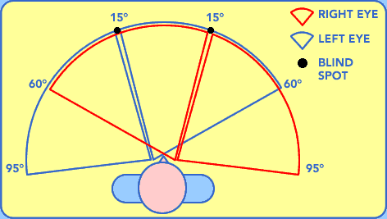
What are sensors?
They are simply a method of detecting things in the world.
They are often implemented using collision detection to mimic “seeing” or “hearing” something in the world.
They often record an object’s position and direction in a working memory.

Slide 19
More on Conditions
Don’t check the sensors only when checking a condition. Continually write sensor data to working memory then read from that memory.
Use conditions when you want to check something at a particular point of execution; decorators make more sense when checking regardless of the child’s state.

Slide 20
More on Actions
Actions could be complex -- They may include playing an animation (returning “running” until the animation completes”), moving to a location or firing a weapon.
Actions could be very simple, too. They may simply set a variable representing a decision in working memory, such as “wants_to_fire” and a controller could later read from memory to perform the desired action.

